Slide 1

UE20CS390B – Capstone Project Phase – 2
SEMESTER - VII
END SEMESTER ASSESSMENT
Project Title : Pill Detection and Medical Chatbot for Disease Prediction
Project ID : PW23_PH_02
Project Guide : Dr. Priyanka H
Project Team : PES1UG21CS682_Rohan T P
PES1UG21CS687_Satvikkumar H
PES1UG21CS693_Sudeepa N S
PES1UG21CS711_Sumanth C

Slide 2
Outline
Pill Detection and Medical Chatbot for Disease prediction
Abstract
Team Roles and Responsibilities.
Summary of Methodology
Design Description
Project Demonstration and Walkthrough
Results
Conclusion and Future Work
References

Slide 3
Abstract
Pill Detection and Medical Chatbot for Disease prediction
This research introduces an innovative framework that combines image processing techniques for pill detection and machine learning algorithms for disease prediction. The primary objective is to develop a comprehensive system that can analyze images of medication, identify pills accurately. The pill detection component employs advanced computer vision algorithms to recognize and classify pills from images, ensuring a reliable and efficient identification process. By seamlessly integrating this pill detection module with disease prediction models, the proposed framework aims to enhance medication adherence monitoring and provide early insights into potential health risks associated with specific medications.
The pill detection system utilizes convolutional neural networks (CNNs) to extract meaningful features from pill images, enabling robust classification of various shapes, colors, and imprints. This approach ensures the system's adaptability to a wide range of medications commonly prescribed for different diseases. Moreover, the integration of disease prediction models, trained on comprehensive healthcare datasets, enables the framework to establish correlations between prescribed medications and potential health outcomes. By leveraging machine learning techniques, the system can identify patterns and associations that may not be apparent through traditional medical assessments, thereby contributing to more personalized and proactive healthcare.

Slide 4
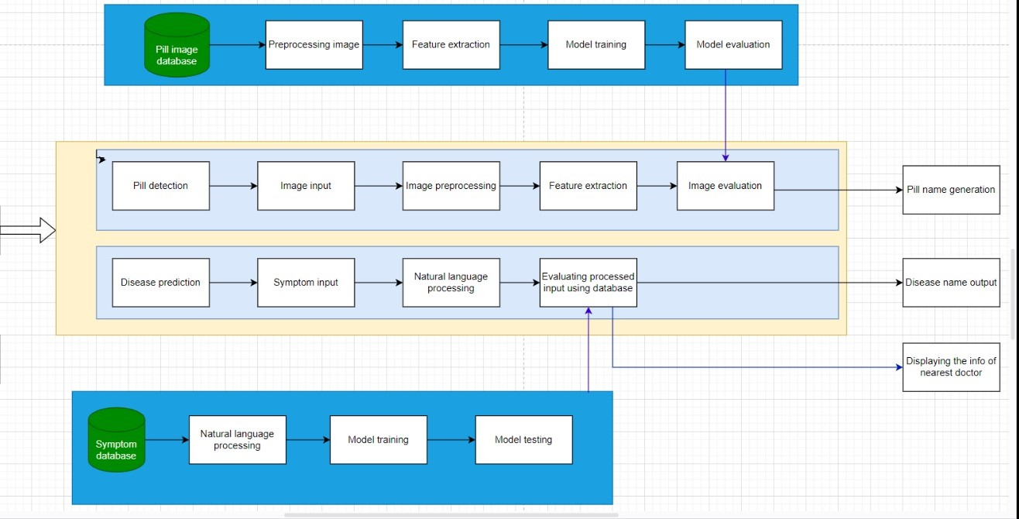
Summary of Methodology
Pill Detection and Medical Chatbot for Disease prediction
Fig 1. System Architecture
Notes:
Bi-LSTM Architecture

Slide 5
Summary of Methodology
Pill Detection and Medical Chatbot for Disease prediction
The methodology for disease prediction using decision trees involves a systematic approach to harness the power of machine learning algorithms in healthcare. The process begins with data collection, where relevant medical information is gathered from diverse sources, including patient records, laboratory results, and demographic details. The next step involves data preprocessing, where the collected information is cleaned, organized, and transformed into a suitable format for analysis. Feature selection is crucial in identifying the most influential variables for accurate predictions. These algorithms iteratively partition the data based on the most discriminative features, creating a tree-like structure that represents decision rules. Model evaluation and validation follow, ensuring the predictive accuracy and generalization of the model to new, unseen data. The resulting decision tree can serve as a valuable tool for clinicians in predicting disease outcomes, aiding in early diagnosis and personalized treatment strategies. Regular updates and refinement of the model with new data contribute to its ongoing effectiveness in disease prediction.
Notes:
Bi-LSTM Architecture

Slide 6
Summary of Methodology
Pill Detection and Medical Chatbot for Disease prediction
The methodology for pill detection using images involves a systematic process that combines computer vision techniques and machine learning algorithms to accurately identify and classify pills from visual data. The first step typically involves data collection, where a diverse dataset of pill images is gathered to train the model. Preprocessing techniques, such as image normalization and augmentation, are applied to enhance the dataset's quality and variety. Subsequently, a Convolutional Neural Network (CNN) or a similar deep learning architecture is trained on the prepared dataset to learn the distinctive features of different pill types. The trained model is then fine-tuned and optimized to improve its accuracy. During the testing phase, new images are fed into the model, and its predictions are evaluated against ground truth labels. Post-processing steps, such as thresholding and filtering, may be applied to enhance the final results. Continuous refinement and validation of the model ensure its effectiveness in real-world scenarios, contributing to the reliable detection of pills using images.
Notes:
CloudSim Architecture

Slide 7
Implementation
Pill Detection and Medical Chatbot for Disease prediction
Pill detection
Input: The image of pill we want to predict as shown.
Output:The name of the pill uploaded.
The steps to construct the model are:
1.Define constants and class names
2.Create a Sequential mode
3.Define the model architecture
4.Load pre-trained weights
5.Define a function for pill detection from an image file
6.Load and preprocess the image
7.Make predictions using the model
8.Visualize the image and display the prediction

Slide 8
Pseudocode
Pill Detection and Medical Chatbot for Disease prediction
Disease Prediction
Input: The symptoms patients are facing.
Output: The disease and the diagnosis the patients.
The steps to construct the models are:
Data loading and preprocessing
Extract features and target variable
Label encoding
Train-test split
Train Decision Tree Classifier
Cross-validation
Symptom mapping and prediction
Disease information retrieval

Slide 9
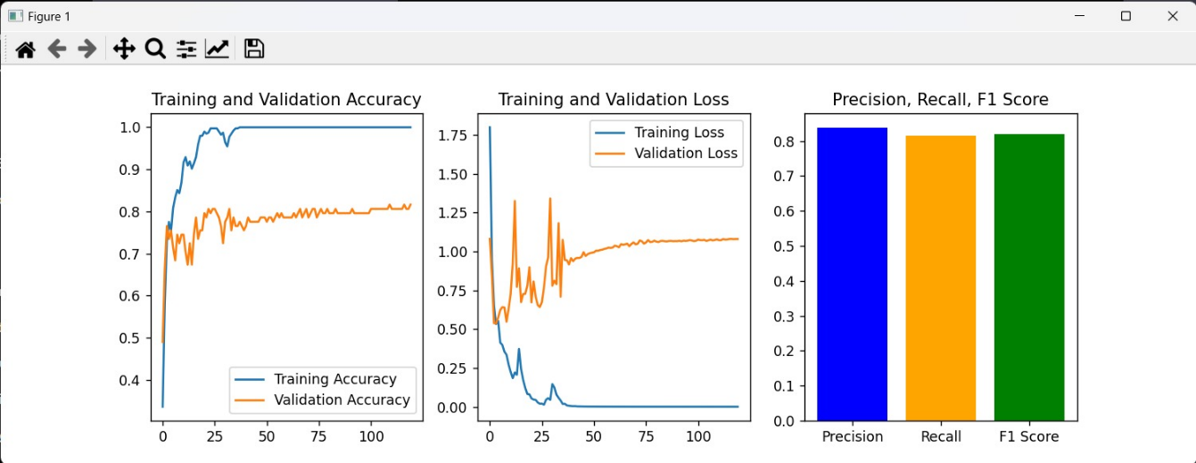
Results
Pill Detection and Medical Chatbot for Disease prediction
Fig 1. Accuracy of model
Notes:
Accuracy of model

Slide 10
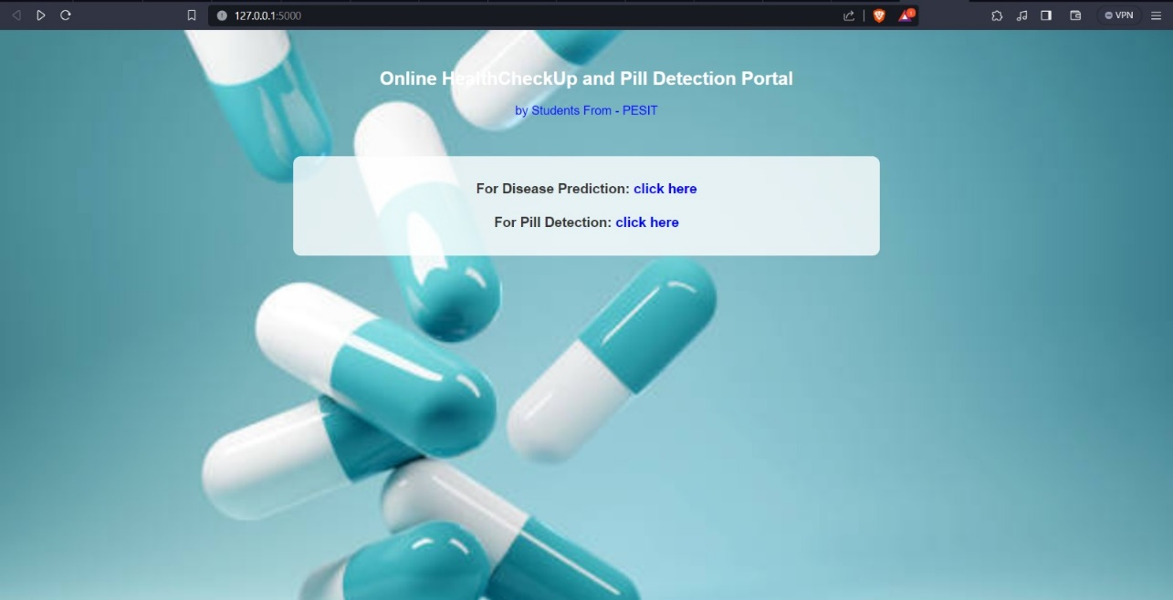
Results
Pill Detection and Medical Chatbot for Disease prediction
Fig 2. Home page

Slide 11
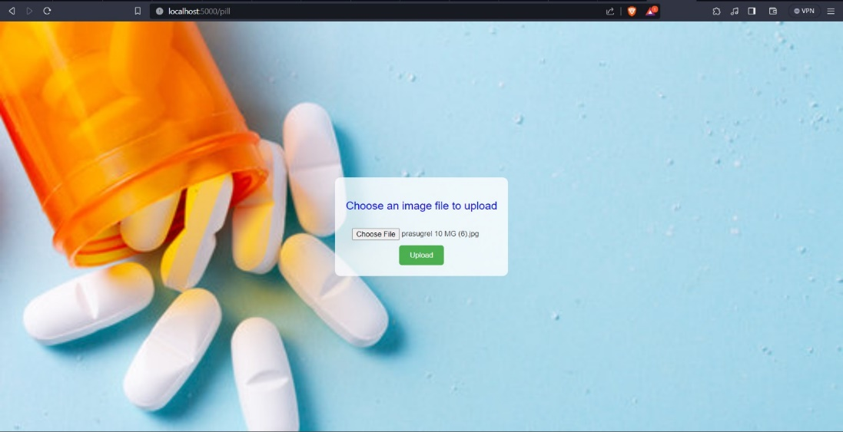
Results
Pill Detection and Medical Chatbot for Disease prediction
Fig 3. Pill Upload page

Slide 12
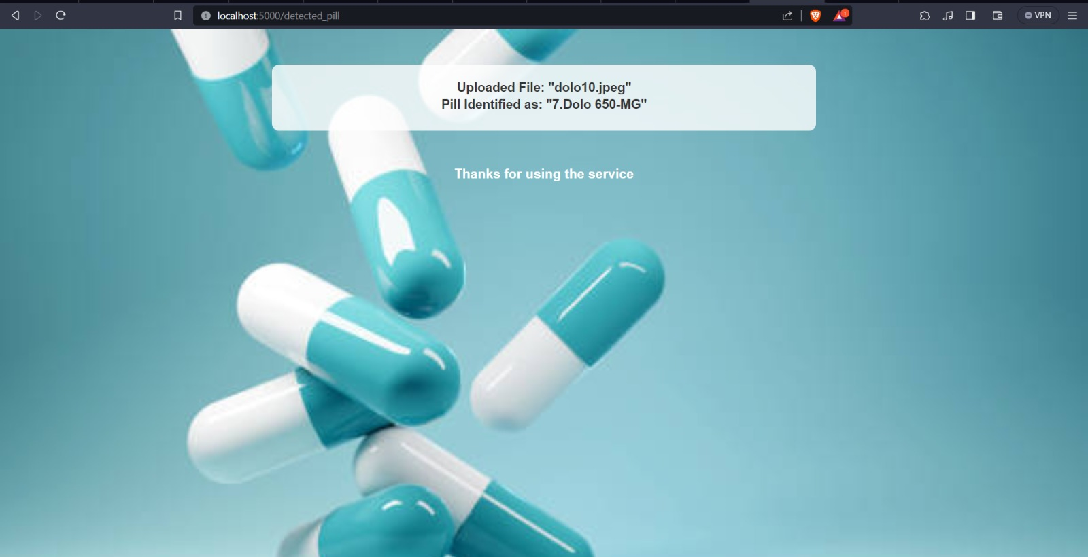
Results
Pill Detection and Medical Chatbot for Disease prediction
Fig 4. Pill Prediction Page

Slide 13
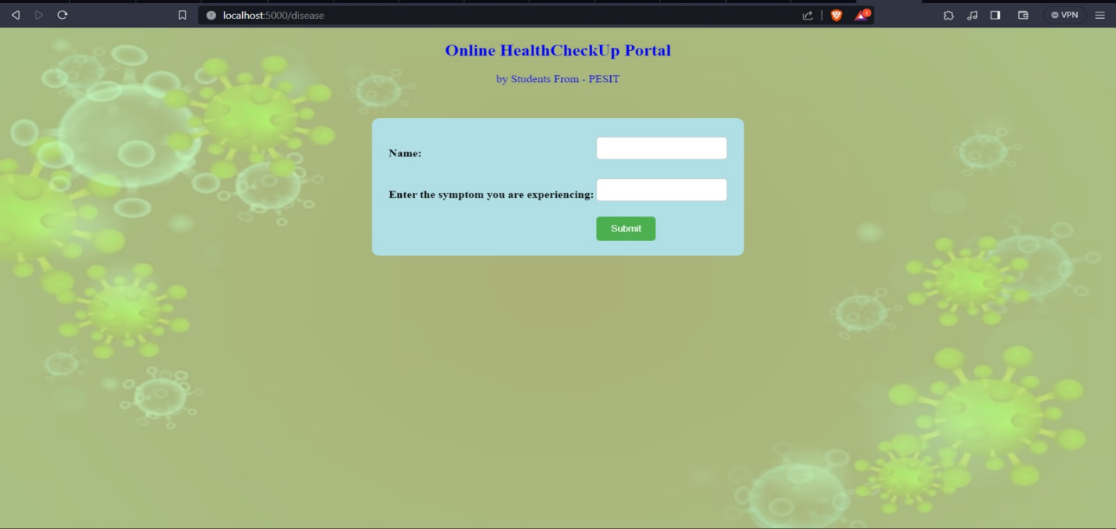
Results
Pill Detection and Medical Chatbot for Disease prediction
Fig 6. Disease Prediction Home Page

Slide 14
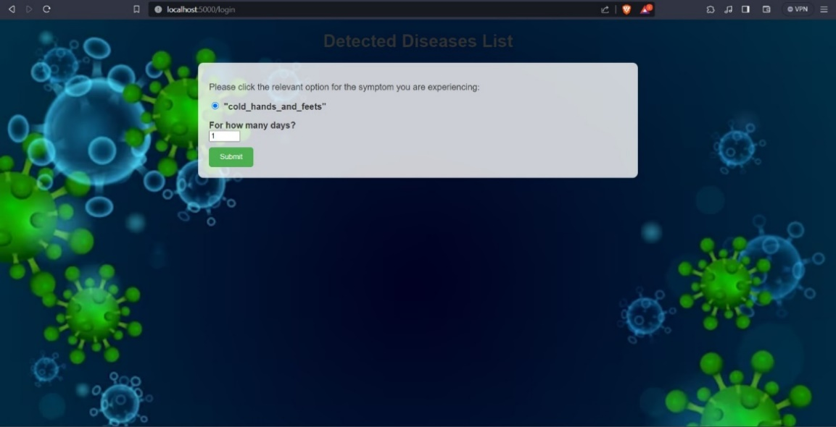
Results
Pill Detection and Medical Chatbot for Disease prediction
Fig 7. Additional symptoms and number of days input page

Slide 15
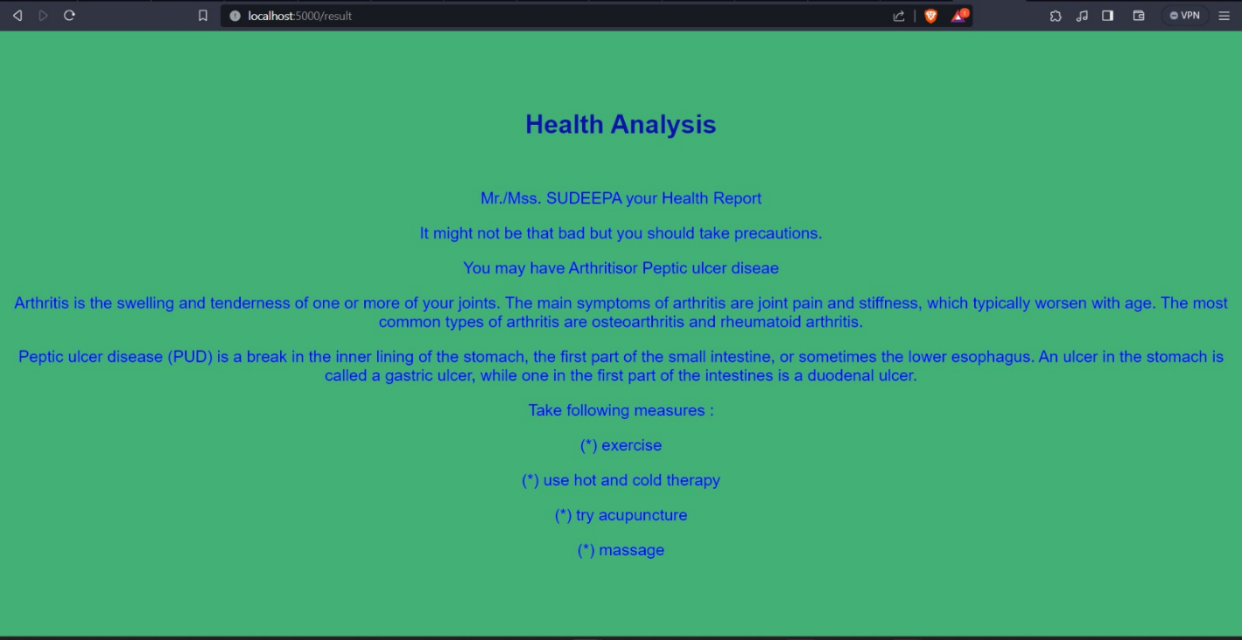
Results
Pill Detection and Medical Chatbot for Disease prediction
Fig 8.Health Analyis page

Slide 16
Conclusion and Future work
Pill Detection and Medical Chatbot for Disease prediction
In conclusion, the integration of image-based pill detection and disease prediction in this project marks a significant advancement in healthcare technology. Leveraging the power of image recognition algorithms, the system demonstrates remarkable accuracy in identifying and classifying pills based on visual information. Furthermore, the seamless incorporation of disease prediction enhances the project's utility by providing a holistic approach to healthcare management. This innovative solution holds great promise in streamlining medication adherence and facilitating early disease detection, ultimately contributing to improved patient outcomes and healthcare efficiency. As technology continues to evolve, the synergistic combination of image analysis and predictive modeling showcases the potential to revolutionize personalized medicine and enhance the overall quality of healthcare delivery.
In future we are trying to integrate finding doctors based on the disease predicted and increase the accuracy for pill detection.

Slide 17
References
Pill Detection and Medical Chatbot for Disease prediction
[1]. Ayanouz, Soufyane & Anouar Abdelhakim, Boudhir & Benhmed, Mohammed. (2020). A Smart Chatbot Architecture based NLP and Machine Learning for Health Care Assistance. 10.1145/3386723.3387897.
[2]. Wang, Yu, Javier Ribera, Chang Liu, Sri Kalyan Yarlagadda and Fengqing Maggie Zhu. “Pill Recognition Using Minimal Labeled Data.” 2017 IEEE Third International Conference on Multimedia Big Data (BigMM) (2017): 346-353.’
[3]. S. Chakraborty et al., "An AI-Based Medical Chatbot Model for Infectious Disease Prediction," in IEEE Access, vol. 10, pp. 128469-128483, 2022, doi: 10.1109/ACCESS.2022.3227208.
[4]. J. J. Caban, A. Rosebrock and T. S. Yoo, "Automatic identification of prescription drugs using shape distribution models," 2012 19th IEEE International Conference on Image Processing, Orlando, FL, USA, 2012, pp. 1005-1008, doi: 10.1109/ICIP.2012.6467032.

Slide 18
References
Pill Detection and Medical Chatbot for Disease prediction
[5]. Y. -Y. Ou, A. -C. Tsai, J. -F. Wang and J. Lin, "Automatic Drug Pills Detection based on Convolution Neural Network," 2018 International Conference on Orange Technologies (ICOT),Nusa Dua, Bali, Indonesia, 2018, pp. 1-4, doi: 10.1109/ICOT.2018.8705849
[6]. P. I. Prayitno, R. P. Pujo Leksono, F. Chai, R. Aldy and W. Budiharto, "Health Chatbot Using Natural Language Processing for Disease Prediction and Treatment," 2021 1st International Conference on Computer Science and Artificial Intelligence (ICCSAI), Jakarta, Indonesia, 2021, pp. 62-67, doi: 10.1109/ICCSAI53272.2021.9609784.
[7] P. Srivastava and N. Singh, "Automatized Medical Chatbot (Medibot)," 2020 International Conference on Power Electronics & IoT Applications in Renewable Energy and its Control (PARC), Mathura, India, 2020, pp. 351-354, doi: 10.1109/PARC49193.2020.236624
[8]. L. Athota, V. K. Shukla, N. Pandey and A. Rana, "Chatbot for Healthcare System Using Artificial Intelligence," 2020 8th International Conference on Reliability, Infocom Technologies and Optimization (Trends and Future Directions) (ICRITO), Noida, India, 2020, pp. 619-622, doi: 10.1109/ICRITO48877.2020.9197833.

Slide 19
References
Pill Detection and Medical Chatbot for Disease prediction
[9] P. -T. Wu, T. -Y. Sun, J. -C. Lin and C. -L. Chin, "Round Pill Shape Recognition System Based on AY Deep Learning Model," 2022 IEEE International Conference on Consumer Electronics - Taiwan, Taipei, Taiwan, 2022, pp. 553-554, doi: 10.1109/ICCE-Taiwan55306.2022.9869124.
[10]. P. Anandan, S. Kokila, S. Elango, P. Gopinath and P. Sudarsan, "Artificial Intelligence based Chat Bot for Patient Health Care," 2022 International Conference on Computer Communication and Informatics (ICCCI), Coimbatore, India, 2022, pp. 1-4, doi: 10.1109/ICCCI54379.2022.9740912.
[11]. L. S. Cordeiro, J. S. Lima, A. I. Rocha Ribeiro, F. N. Bezerra, P. P. Rebouças Filho and A. R. Rocha Neto, "Pill Image Classification using Machine Learning," 2019 8th Brazilian Conference on Intelligent Systems (BRACIS), Salvador, Brazil, 2019, pp. 556-561, doi: 10.1109/BRACIS.2019.00103
[12] J. Liu, M. Zhu, T. Cai, D. Kong and Y. Xing, "Intelligent Tablet Detection System Based on Capsule Neural Network," 2022 IEEE 2nd International Conference on Power, Electronics and Computer Applications (ICPECA), Shenyang, China, 2022, pp. 665-669, doi: 10.1109/ICPECA53709.2022.9719182.

Slide 20
References
Pill Detection and Medical Chatbot for Disease prediction
[13] Suntronsuk, S., & Ratanotayanon, S. (2016). Pill image binarization for detecting text imprints. 2016 13th International Joint Conference on Computer Science and Software Engineering (JCSSE). doi:10.1109/jcsse.2016.7748859 10.1109/JCSSE.2016.7748859
[14]Suntronsuk, S., & Ratanotayanon, S. (2017). Automatic text imprint analysis from pill images. 2017 9th International Conference on Knowledge and Smart Technology (KST). doi:10.1109/kst.2017.7886081
[15] R. B. Mathew, S. Varghese, S. E. Joy and S. S. Alex, "Chatbot for Disease Prediction and Treatment Recommendation using Machine Learning," 2019 3rd International Conference on Trends in Electronics and Informatics (ICOEI), Tirunelveli, India, 2019, pp. 851-856, doi: 10.1109/ICOEI.2019.8862707

Slide 21
Thank You

